Slide 1
Aranet – broadest reach, simplest solutions

Slide 2
TECHNOLOGY
LPWAN (Low Power Wide Area Network) technology
Proprietary protocol
Sub GHz frequencies
Large range (at least 3km/1.9mi LoS)
Good surface penetration
Low power requirements.
+

Slide 3
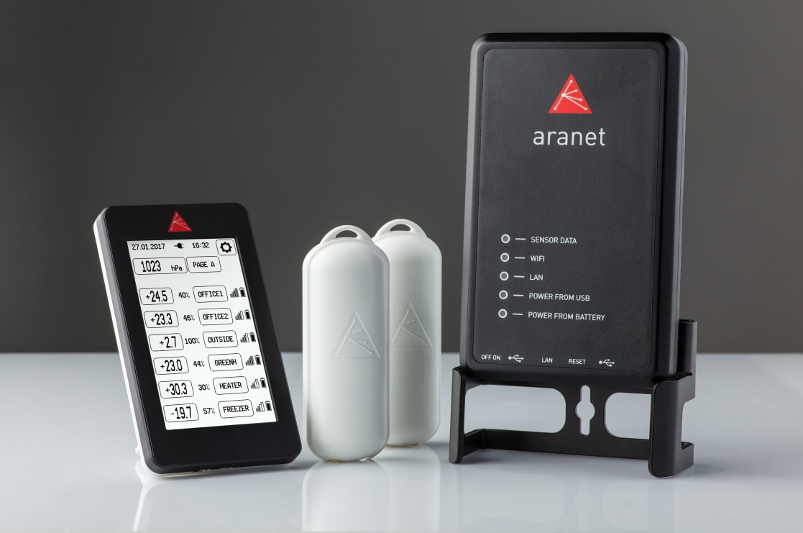
WHAT IS ARANET?
Aranet is a wireless monitoring solution designed for industrial use.
The technical solution allows for wireless sensor deployment within at least 3km line-of-sight distance from the base station.
Operating as a safe, private network that’s not dependent on any third-party service provider.
Sensors are made to be robust and reliable to be deployed in harsh environments and still deliver reliable data readings.
Software for data analysis is easy to work with allowing for quick installation of the sensor network.

Slide 4
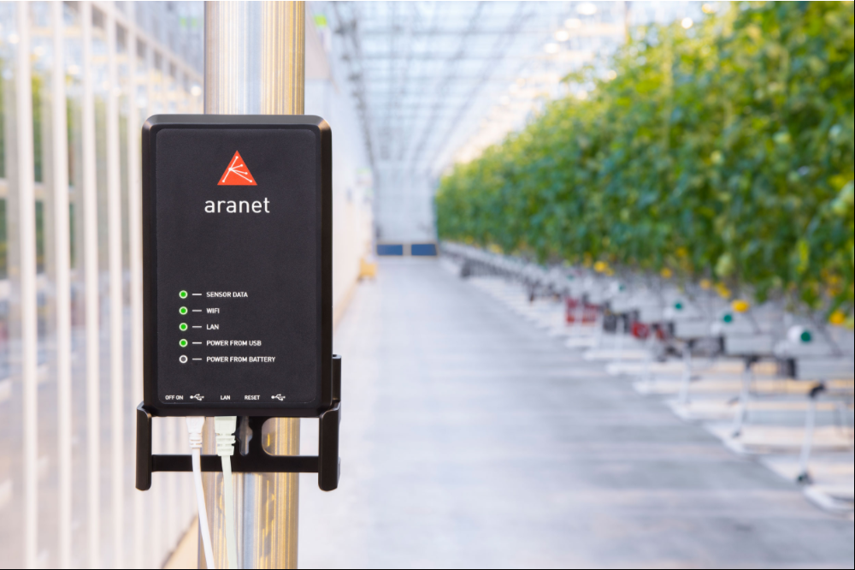
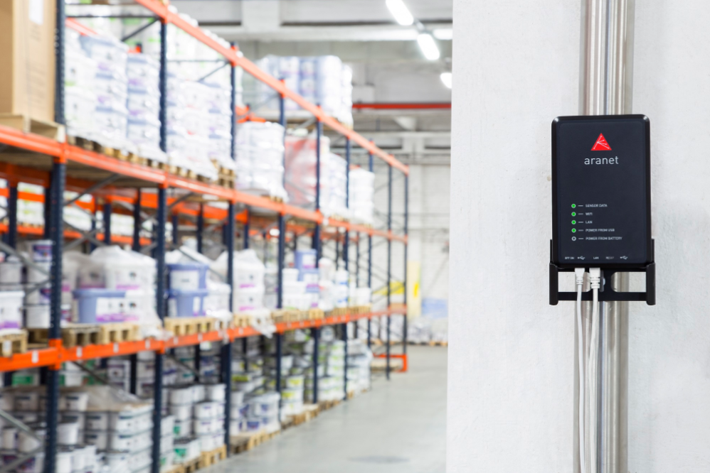
WHO IS ARANET FOR?
Aranet sensors offer business critical information to several industries, such as food manufacturing, warehouses, agriculture, building management and others.
Current sensor support allows collecting information about temperature, relative humidity and CO₂ levels.
Alarms and easy to work with software makes Aranet an asset that helps to improve productivity and avoid costly mistakes!

Slide 5
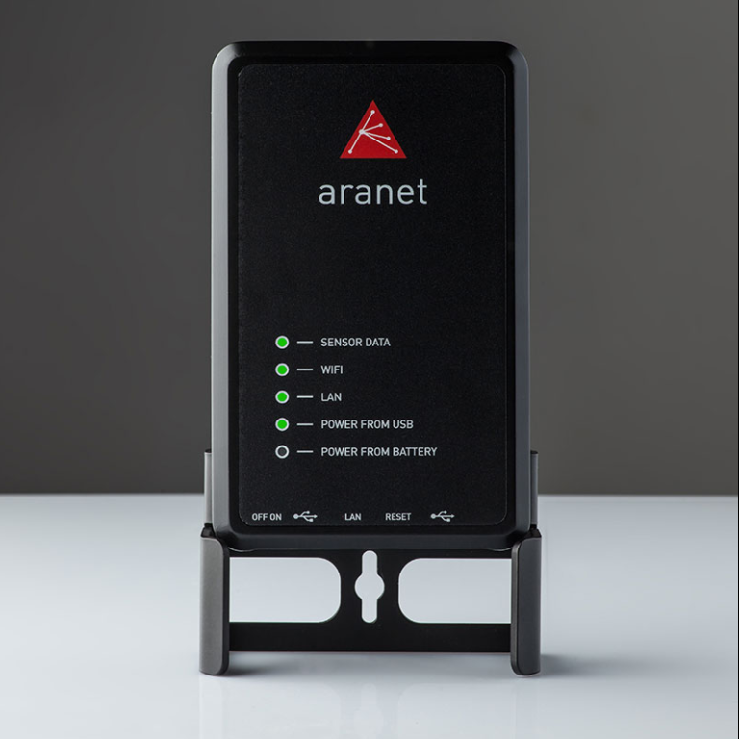
ARANET PRO
An industrial grade environment monitoring solution. Complimentary data anlysis software.
Aranet PRO variations – Aranet PRO 12, Aranet PRO 50 and Aranet PRO 100
Designed to streamline workflow for business critical information monitoring and analysis
No need for additional hardware – data storage and management functionality all in one
Software interface for viewing the data on PC or smart devices
Up to 100 sensor support per base station
Easy xlsx and csv data export for further analytics

Slide 6
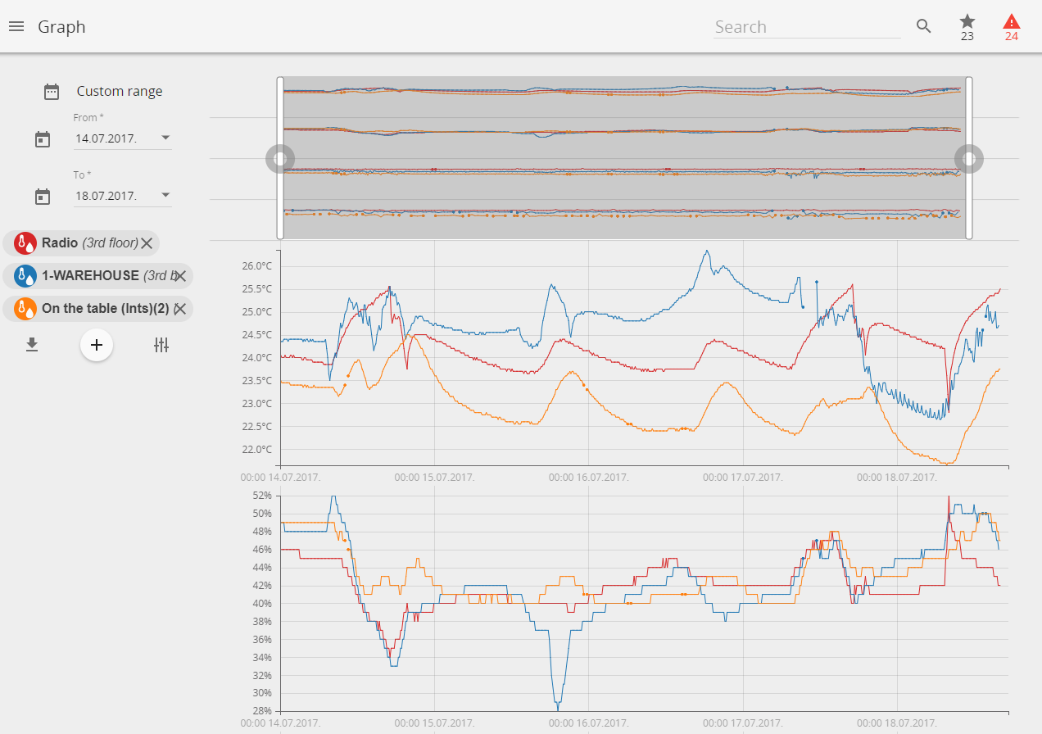
ARANET SensorHUB SOFTWARE
Easy to use interface allows viewing, analysing and comparing data in real time, set thresholds for alarms as well as exporting reports. Responsive design adapts to smartphone, tablet or laptop.
Optimized UI/UX for desktop and mobile use;
Simple design ;
Advanced graph functionality for data analysis;
E-mail and SMS alarm functionality;
Easy renaming and grouping of sensors for quick sensor management;
Alarm and favorite filters for quick views of the most critical sensor readings;

Slide 7
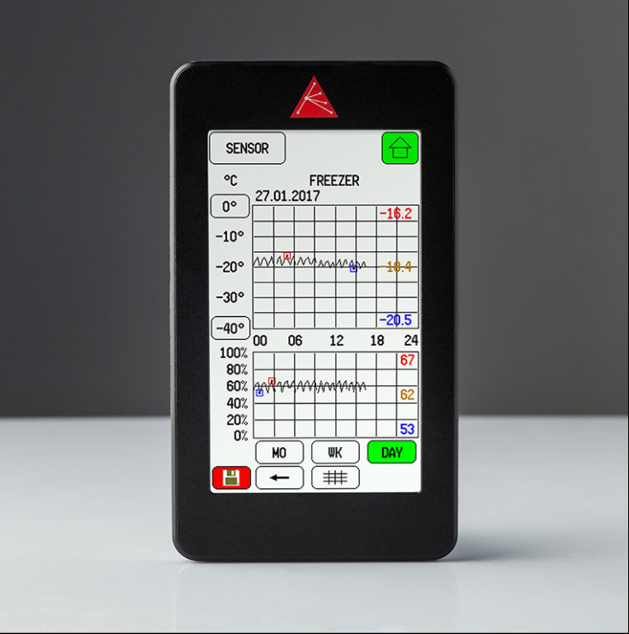
ARANET MINI
Aranet MINI autonomous base station is a perfect solution for environmental monitoring if precision, autonomy and long range is required. Suitable for smaller site size applications.
Simple tool for quick local monitoring of sensors;
Built in resistive screen for working with gloves
Graphical interface for viewing the data;
Up to 12 sensor support per base station;
Built in barometer;
Simple data export;

Slide 8
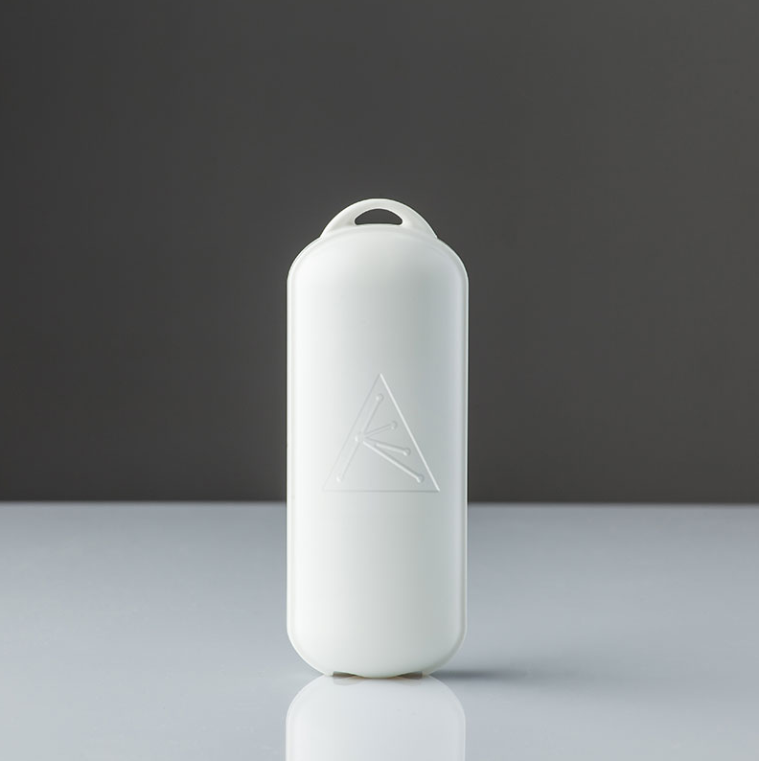
ARANET T/RH SENSOR
The Aranet relative humidity and temperature sensor delivers critical information for storage of goods, building maintenance and other.
Measures temperature (-40°C to 60°C/-40°F to 140 °F), relative humidity (0% to 100%)
Data Transmission - every 10 minutes
Up to 10 year battery life
Protection class IP42
For outdoor and indoor use
Dimensions 115x44x25 mm/ 4.5x1.7x1 in

Slide 9
ARANET CO₂ SENSOR
The Aranet CO₂ is one of the first wireless CO₂ level measuring devices that are battery powered. By using infrared technology it delivers reliable data for your business.
Measures CO₂ level from 0-9999 Ppm
Data Transmission - every 10 minutes
Up to 2 year battery life
Protection class IP42
For indoor use
Dimensions 115x44x25 mm/ 4.5x1.7x1 in

Slide 10
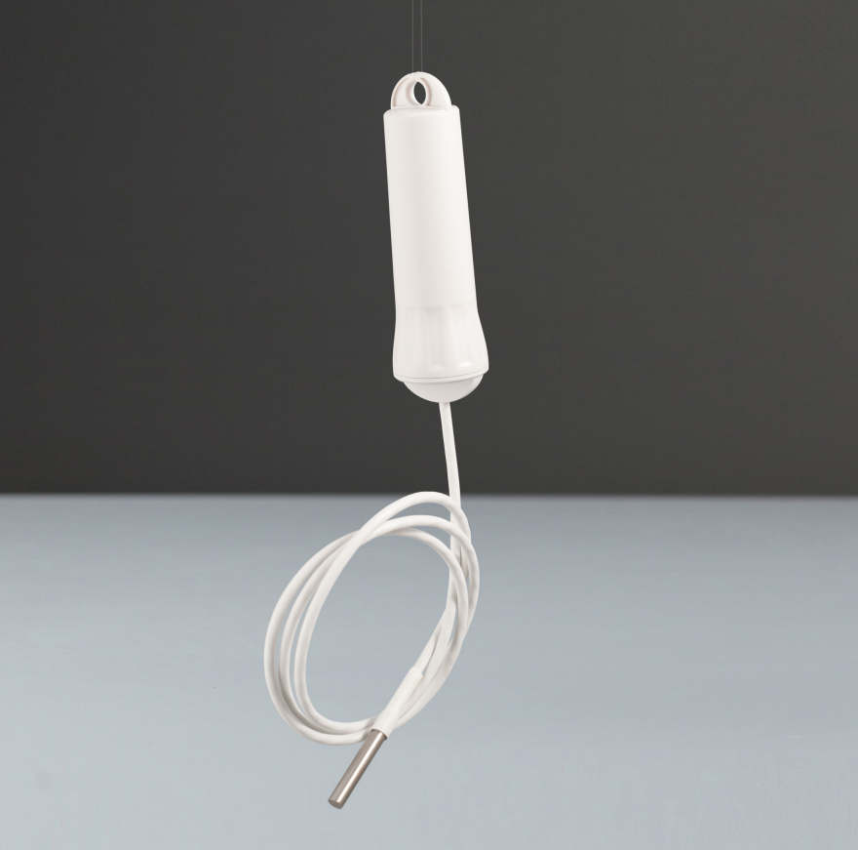
ARANET T-PROBE SENSOR
The Aranet temperature probe sensor allows you to measure temperature in difficult to reach places, measure air, surface or liquid temperature.
Measures temperature from -55°C to 105 °C/ -67°F to +257°F
Up to 10 meter long probe
Data Transmission - every 10 minutes
Up to 7 year battery life
Protection class IP68
For indoor or outdoor use
Dimensions 35mmØx120mm / 1.4inØx4.7in

Slide 11
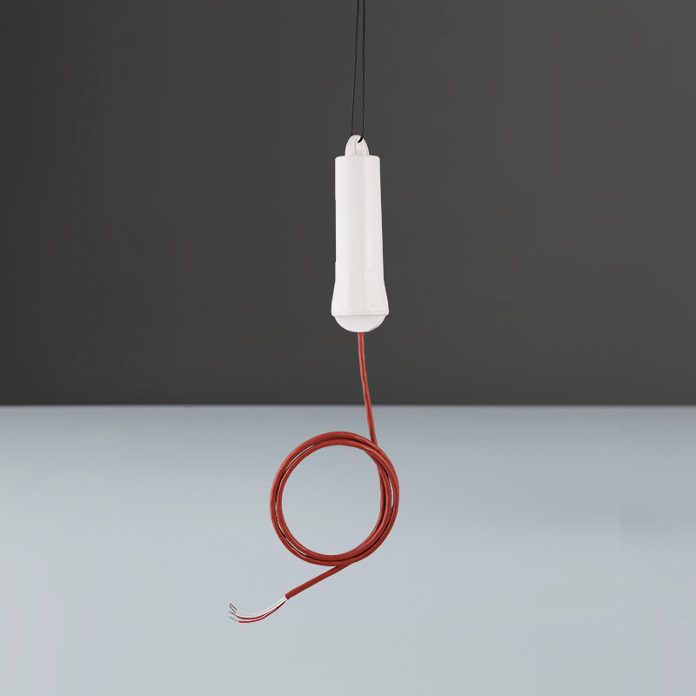
ARANET PT100 TRANSMITTER
Aranet PT100 Transmitter is an easy-to-use resistance-to-digital converter optimized for platinum resistance temperature detectors (RTDs).
Measures temperature 200°C (-328°F) up to 800°C (1472°F);
Probe type: Any class PT100;
2-wire and 4-wire connections
Up to 10 meter long probe;
Data Transmission - every 10 minutes;
Up to 7 year battery life;
Protection class IP68;
For indoor or outdoor use;
Dimensions 35mmØx120mm / 1.4inØx4.7in;

Slide 12
BENEFITS
Process optimization- new streams of data to improve decision-making
Reduced maintenance cost – with the exceptionally long battery life of Aranet Sensors there is no need for frequent maintenance
Portability - devices can be moved when necessary without extra costs of installation or extensive planning
24/7 monitoring - avoid damages caused by temperature and humidity fluctuations, identify problems early
Long receiving range of at least 3km/1.9mi (line-of-sight)
Simple installation- savings on costly and time-consuming installation
Remote & centralized data collection – eliminates human error with manual data gathering
Easy to use systems – no long and exhausting equipment and software trainings

Slide 13
WWW.ARANET.COM

